Slide 1


Semiconductor Physics
Semiconductors –versatile uses
Medicine –diagnosis and treatment
Virtual reality-game entertainment
Communication –land, satellite
Aviation –passenger, military
AI –artificial intelligence
Self driving cars –passenger, construction

Slide 2
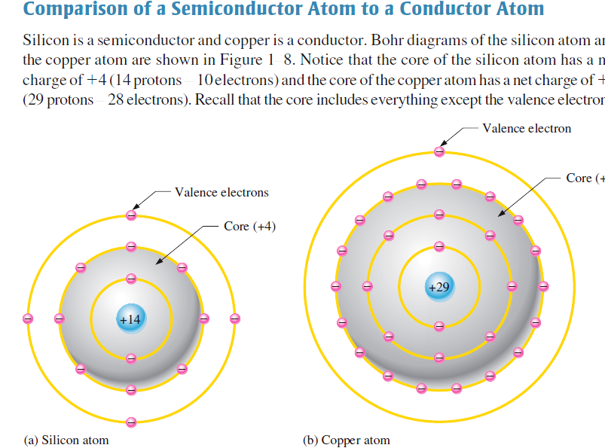
Semiconductor Physics

Slide 3
Semiconductors
1. Semiconducting materials
Materials can be categorized by their ability to conduct electricity
conductors , semiconductors or insulators .
Conductors –conduct electric city
Semiconductors –conduct electric city with the help of thermal energy
Insulators do not conduct -no free electron even with the help of heat
Question-1---if it is possible to mark (for example color red ) a valence electron at a specific position in an insulator ---due think you find it in the same position after some time t?
Question-2-why not we appley large heat energy which is sufficient to excite an electron from valence band to conduction band in an insulator so that it conducts like a semiconductor
Question 3. which pure semiconductor material has the smallest band gap energy
Question -4-how do you change the band gap of a semiconductor
Question-5—give an example for compound semiconductors

Slide 4
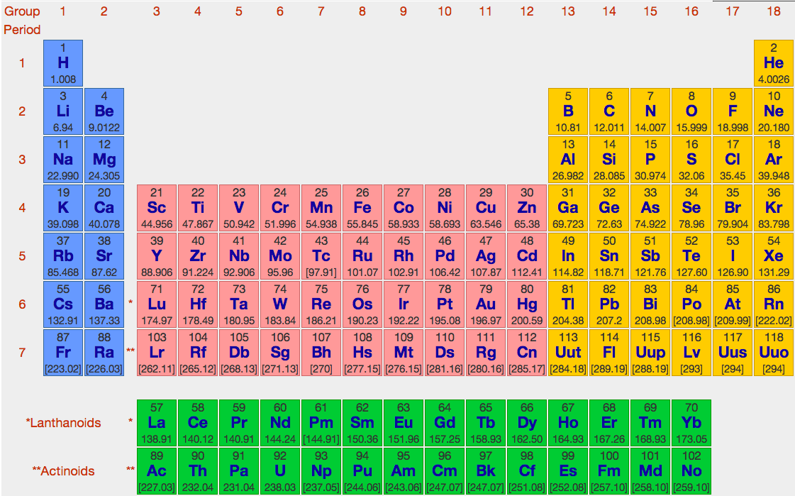
Semiconductors
1. Semiconducting materials

Slide 5
1. Semiconducting materials
Semiconductor Physics
Good conductors, Cu, Ag, and Au conduct electricity with little resistance
They have valence electrons, which is loosely bound to the atom and can easily become a free electron
It is freely movable under an applied voltage to conduct electricity.
Insulators do not conduct electricity as no free electrons exist in the material
The elements in the carbon group have four valence electrons
Their conductivity is not as good as the conductors but better than the insulators,
They are given the name semiconductors
Silicon and germanium are the two important semiconductors as an element

Slide 6
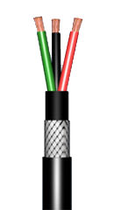
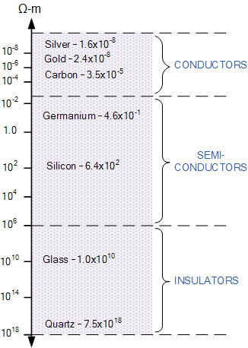
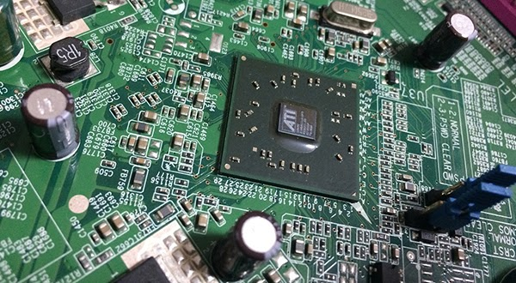
Semiconductors
Semiconducting materials- Range of resistivity
All materials are important
Conductors-conduct
Insulators-insulate
Semiconductors-device fabrication-(connection by conductors and insulation by insulators)
Conductors + insulators+ semiconductors

Slide 7
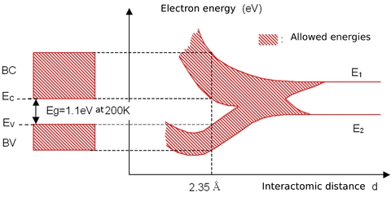
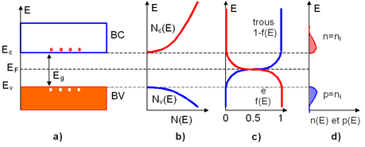

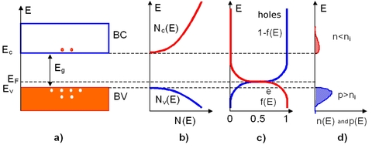
Semiconductor Physics
1. Semiconducting materials-summary
Separate atoms come together and form crystals
Equal number of electrons and holes
Large electrons small holes
Large holes small electrons

Slide 8
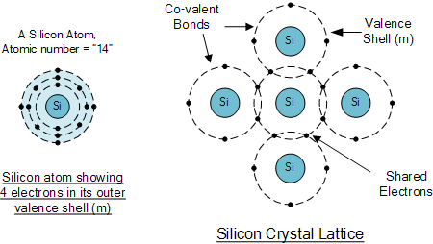
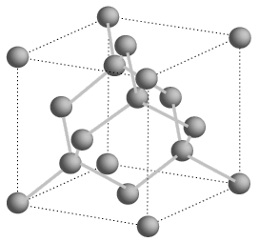
Semiconductors
1. Semiconducting materials
Bonding in semiconductors is covalent bond -Electrons are shared between atoms

Slide 9
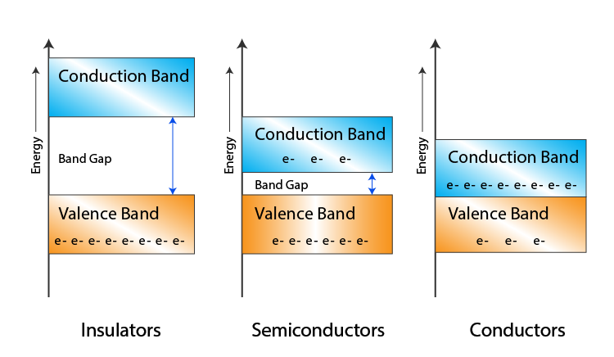
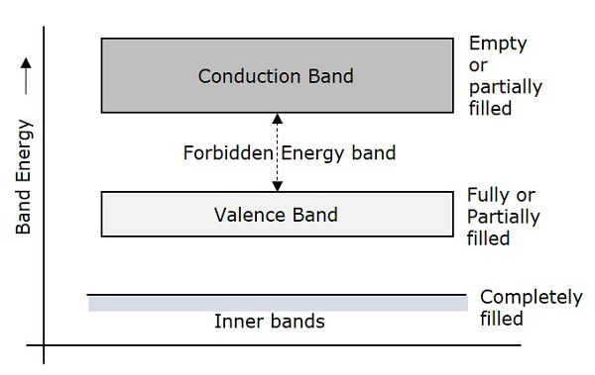
Semiconductors
2. Energy bands in semiconductors -Energy bands are formed because of periodic potential

Slide 10
Semiconductors
2. Energy bands in semiconductors
The electrons creating the covalent bonds in semiconductors and insulators are neither free nor trapped in the potential wells of single atoms
In semiconductors and insulators, there are strong interactions between the valence electrons and the periodic potential due to the positive ions.
These interactions alter the parabolic E–k dependence of free electrons in a way that leads to the appearance of holes as an additional type of current carriers
THE BLOCH THEOREM-The behavior of an electron in a crystalline solid is determined by studying the appropriate Schrodinger equation

Slide 11
Semiconductors
2. Energy bands in semiconductors
Energy Gaps and General Band Structure
electrons not at the bz obey the relation for the total energy E
Electron waves with wave vectors on or near a BZ are diffracted;

Slide 12
Semiconductors
2. Energy bands in semiconductors
a reduced representation of the band diagram,

Slide 13
Semiconductors
Band Structures and Standard Representations
Directions are chosen from the center of the Brillouin zones - to special symmetry points.
These points are labeled according to the following rules:
Points (and lines) inside the Brillouin zone are denoted with Greek letters.
Points on the surface of the Brillouin zone with Roman letters.
The center of the Wigner-Seitz cell is always denoted by a Γ

Slide 14
Semiconductors
2. Energy bands in semiconductors
Direct and indirect band gap
Circles (º) indicate holes in the valence ) indicate holes in the valence bands and dots ( bands and dots (•) indicate electrons in the ) indicate electrons in the conduction bands.

Slide 15
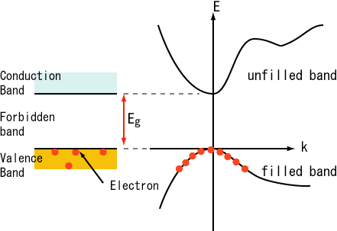
Semiconductors
4. Carrier concentration
n = (free) electron concentration [cm⁻³]
p = hole concentration [cm⁻³]
N_{d} and N_{a} = donor and acceptor concentration [cm⁻³]
n_{i} = intrinsic carrier concentration [cm⁻³]
n^{e} and n^{h} = electron and holes concentration [cm⁻³]

Slide 16
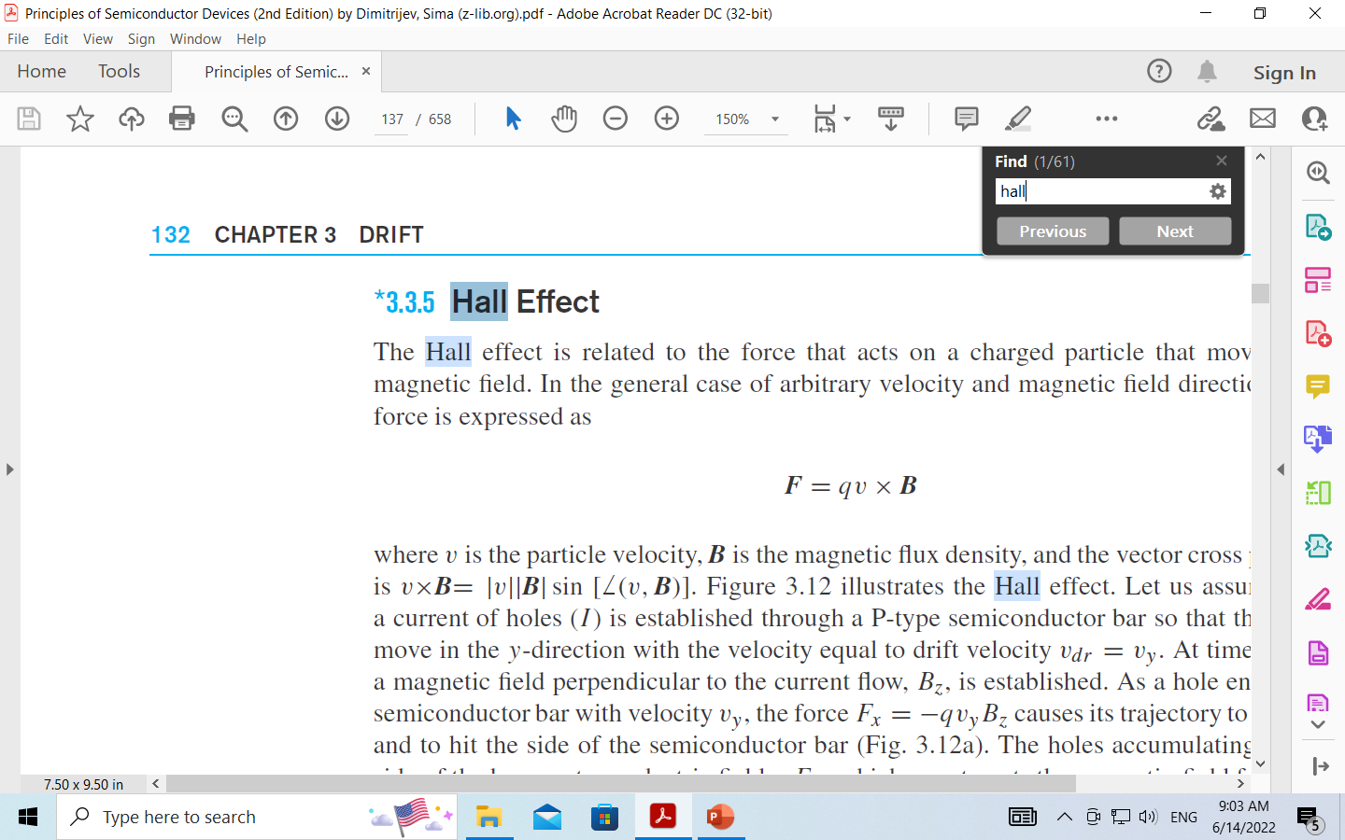
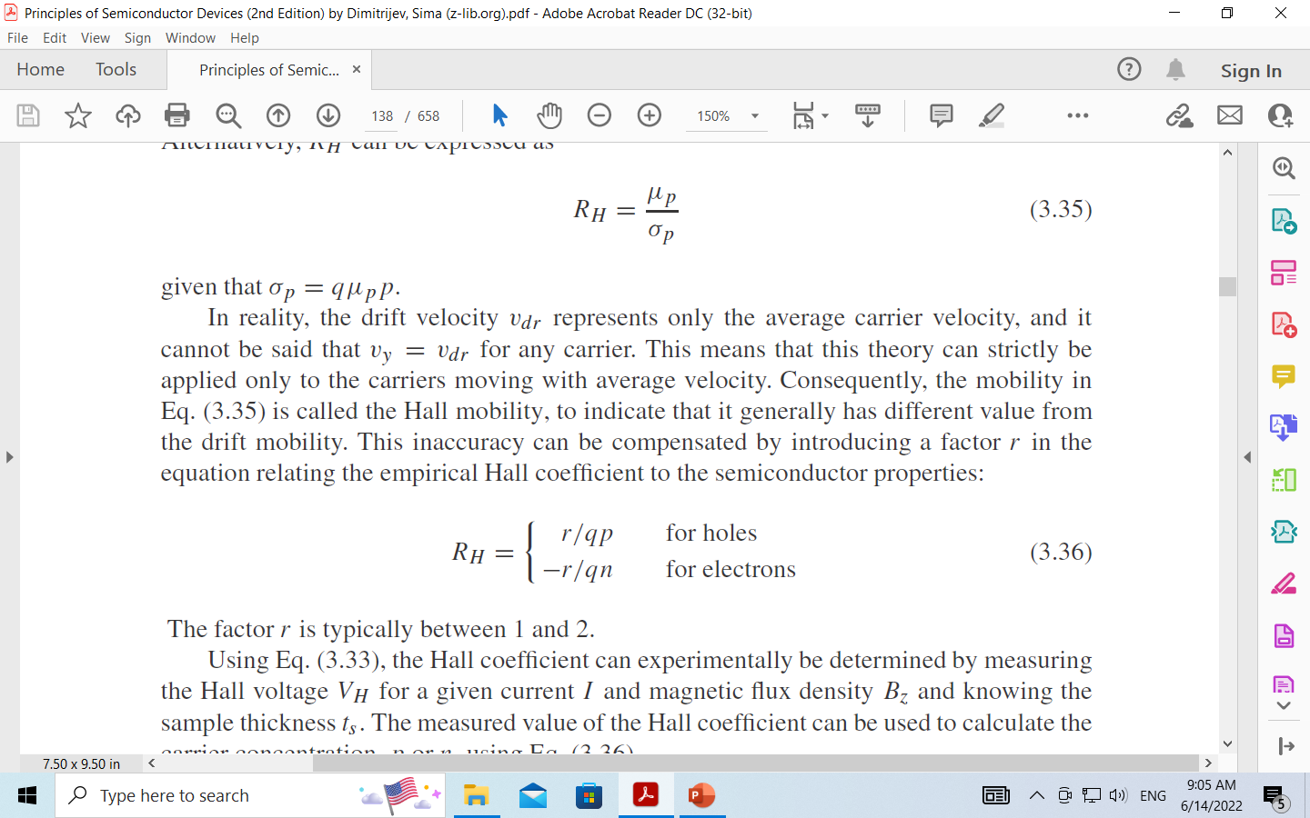
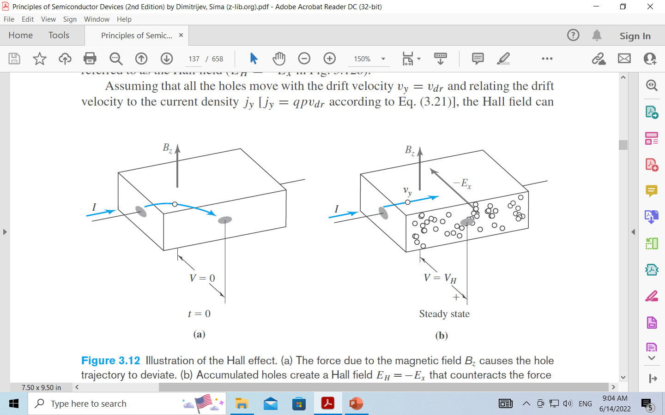
Semiconductors

Slide 17
Semiconductors
4. Carrier concentration
The probability that an electron occupies an electronic state with energy E is given by the Fermi–Dirac distribution function, which is also called the Fermi distribution function
k is the Boltzmann constant,
T is the absolute temperature in degrees Kelvin,
EF is the energy of the Fermi level.
EF – energy of Fermi level (is the energy at which the probability of occupation by electron is exactly one-half)

Slide 18
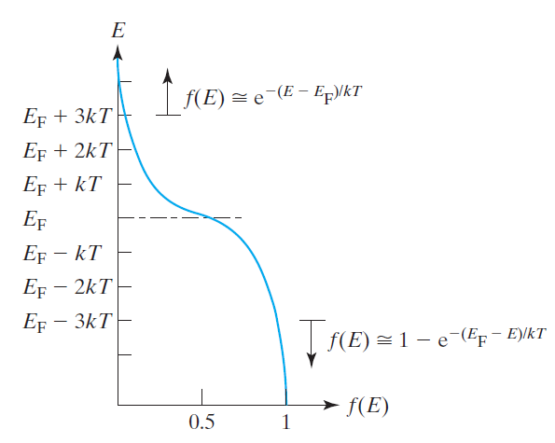
Semiconductors

Slide 19
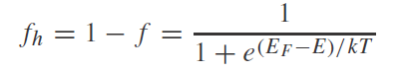
Semiconductors
4. Carrier concentration
The Fermi Dirac distribution function for different thermal energy
For energy, 3kT above or below Fermi energy
Electron distribution –it is in the conduction band
Hole distribution –it is in the valence band
Electron density, n – number electrons per unit volume.

Slide 20
Semiconductors
4. Carrier concentration
Intrinsic semiconductors
The process of covalent-bond breakage creates the free electrons and holes in pairs
The number of current carriers per unit volume (n0) has to be always equal to the concentration of holes ( p0),
Intrinsic carrier concertation at 0K
The intrinsic carrier concentration ni is constant for a given semiconductor at a given temperature
It is dependent on temperature, effective mass and energy band gap

Slide 21
Intrinsic carrier densities in Si and GaAs as a function of the reciprocal of temperature

Slide 22
4. Carrier concentration
Intrinsic semiconductor.
Schematic band diagram.
Density of states. ) Density of states.
Fermi distribution function.
(d) Carrier concentration.

Slide 23
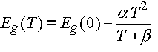
Semiconductors
4. Carrier concentration
Temperature dependence of the energy bandgap
The interatomic spacing increases when the amplitude of the atomic vibrations increases due to the increased thermal energy.
An increased interatomic spacing decreases the potential seen by the electrons in the material, which in turn reduces the size of the energy bandgap.
The temperature dependence of the energy bandgap has been experimentally determined yielding the following expression for E_{g} as a function of the temperature T:
where E_{g}(0), a and b are the fitting parameters
 | Germanium | Silicon | GaAs
E_{g}(0) [eV] | 0.7437 | 1.166 | 1.519
α [eV/K] | 4.77 x 10⁻⁴ | 4.73 x 10⁻⁴ | 5.41 x 10⁻⁴
β [K] | 235 | 636 | 204

Slide 24
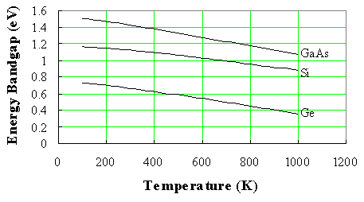
Semiconductors
4. Carrier concentration
Temperature dependence of the energy bandgap
A plot of the resulting bandgap versus temperature is shown in the figure below for germanium, silicon and gallium arsenide.

Slide 25
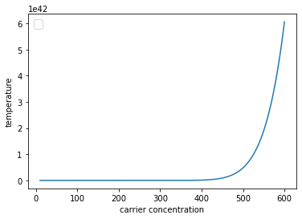
Semiconductors
4. Carrier concentration
Determine the number of holes and electrons for
a. silicon at 400 and 600 K
b. germanium at 400 and 600 K
c. Compare the results

Slide 26
Semiconductors

Slide 27
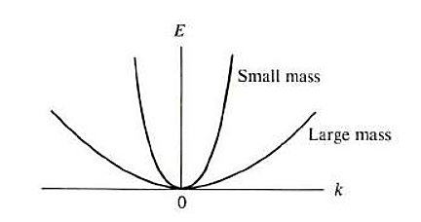
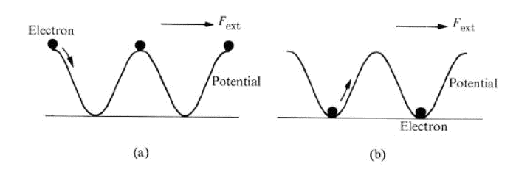
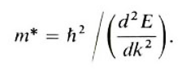
Semiconductors
4. Carrier concentration
Effective Masses
The effective mass m* may be smaller or larger than m_{o}, or even negative, depending on
the lattice force.
Electron spatial distribution leading to an effective mass rn (b) A distribution leading to m* > m₀.

Slide 28
Semiconductors
4. Carrier concentration
Effective Masses
Schematic dispersion of a conduction band
The resulting effective mass

Slide 29
Semiconductors
4. Carrier concentration

Slide 30
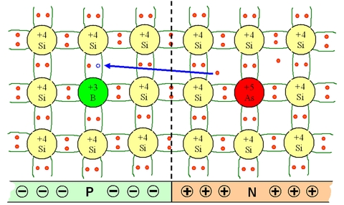
Semiconductors
4.Carrier concentration
Doping in semiconductors produces P and N type semiconductors

Slide 31
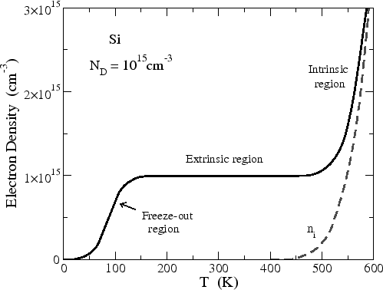
Semiconductors
4. Carrier concentration
Electron density as a function of temperature for a Si sample with a donor concentration of ND

Slide 32
Semiconductors
4. Carrier concentration
N-Type and P-Type Doping
Doping changes concentrations of free electrons and/or holes in semiconductors
N-type -Silicon - four electrons for covalent bonds
Phosphorus- five electron-one electron not bonded --easily liberated by the thermal energy, -becomes a free electron.
P-type doping - a silicon atoms are replaced by atoms from the third column of the periodic table- boron atoms

Slide 33
Semiconductors
4. Carrier concentration
A semiconductor material is electroneutral and
it is expressed by the electroneutrality equation:

Slide 34
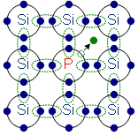
Semiconductors
4. Carrier concentration
phosphorus Atom (donor) and -N-type doping
Phosphorous atom donates its fifth valence electron and it acts as free charge carrier
Number of free charge carriers is dependent on number of donors, Nd
The donors are +vely charged.
There are a large number of free es.
A small number of holes in relation to the number of free es.
Doping gives: positively charged donors & free es.
Supply of energy gives: free es and positively charged holes.

Slide 35
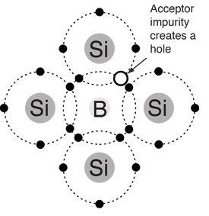
Semiconductors
4. Carrier concentration
Boron atom doping (Acceptor) –P-type
Boron atom accepts one unbonded electron and creates holes.
The number of carriers is dependent on the number of acceptor atoms, Na
The acceptors are negatively charged.
There are a large number of holes.
A small number of free electrons in relation to the number of holes.
Doping gives: negatively charged acceptors. positively charged holes.
Supply of energy gives: positively charged holes. negatively charged free electrons.

Slide 36
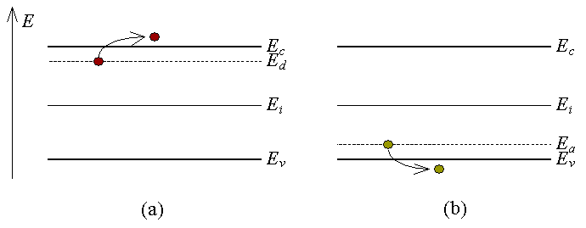
Semiconductors
4. Carrier concentration
Carrier concentration in dopped semiconductors
the donor concentration greatly exceeds the acceptor concentration, that is Nd>>Na.
To a good approximation n=N_{d}. this is called an n-type semiconductor.
when Na>>Nd, that is, the doping is primarily by acceptors.
That is p=Na. Such a material is called a p-type semiconductor.
n_{e} ≠n_{h}
Ionization of
a) a shallow donor and b) a shallow acceptor

Slide 37
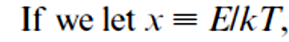
Semiconductors
4. Carrier concentration
The number of carriers is
If we refer to the bottom of the conduction band as Ec instead of E = 0, we obtain for the electron density in the conduction band
where NC is the effective density of states in the conduction band
where NV is the effective density of states in the valence band

Slide 38
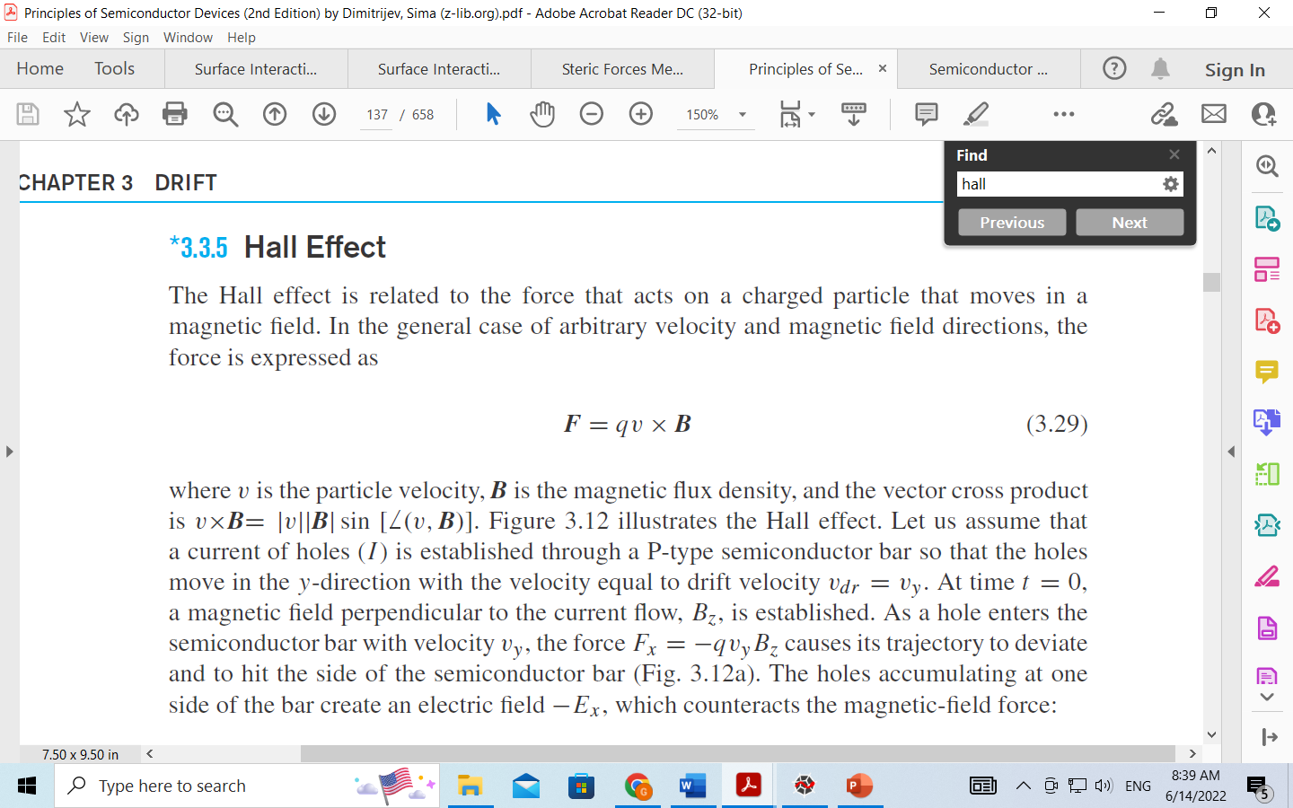
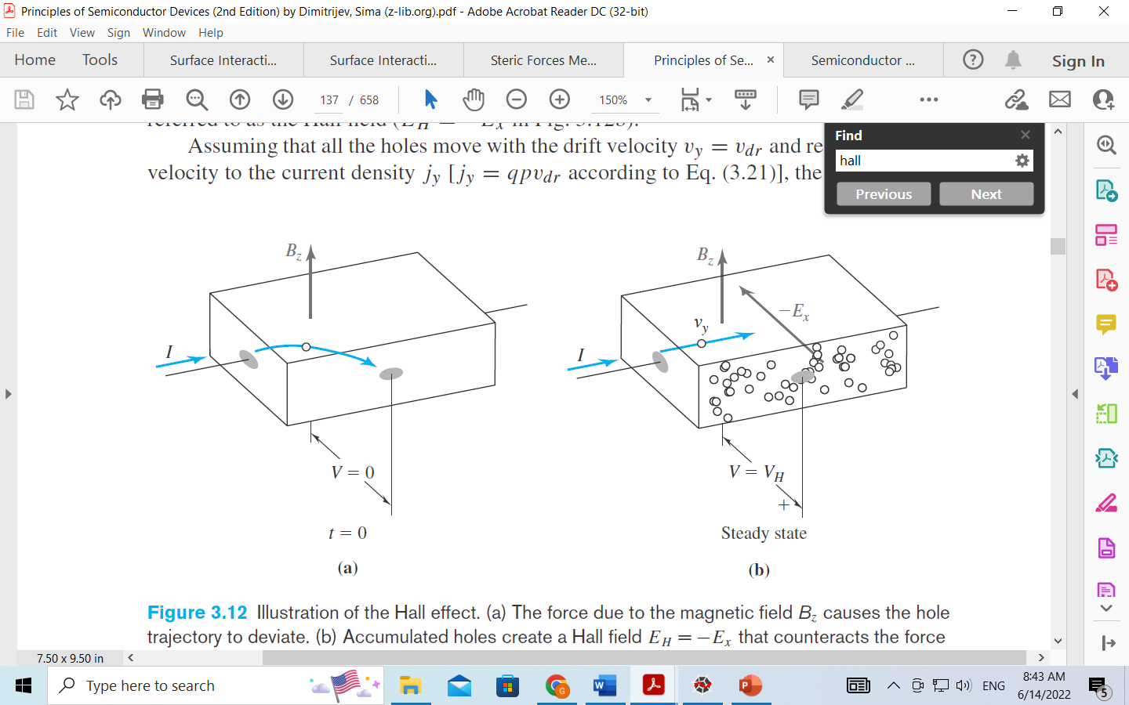
Semiconductors

Slide 39
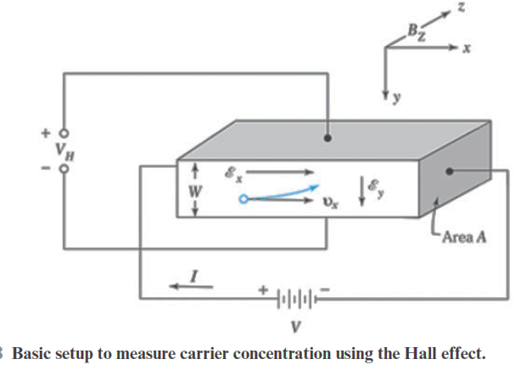

Slide 40
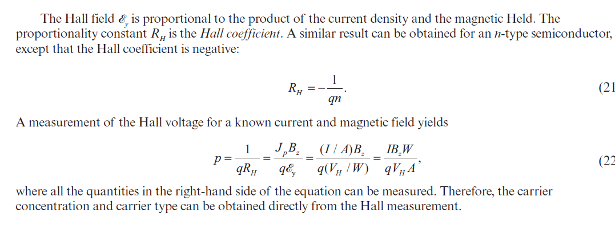

Slide 41
Semiconductors
5. Fermi energy
Position of the Fermi level expresion
Intrinsic semiconductor.
N-type semiconductor.
P-type semiconductor.
The energy as a function of temperatures and donor/acceptor concentration for both N type and p Type semiconductor

Slide 42
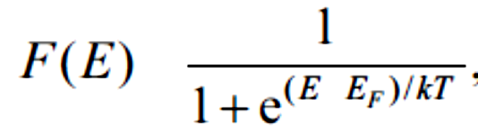
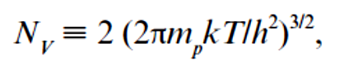
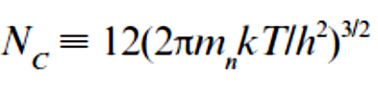
Semiconductors
5. Fermi energy

Slide 43
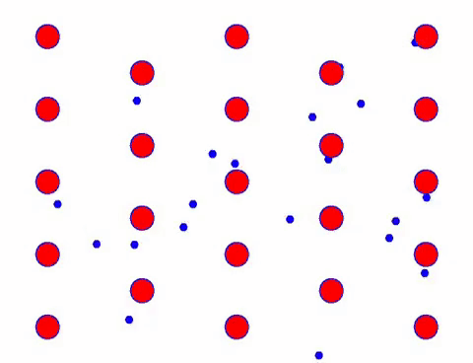
Semiconductors
5. mobility, mean free path and conductivity

Slide 44
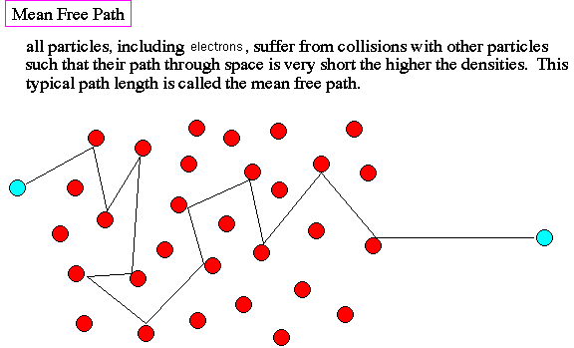
Semiconductors

Slide 45
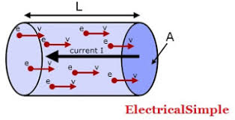
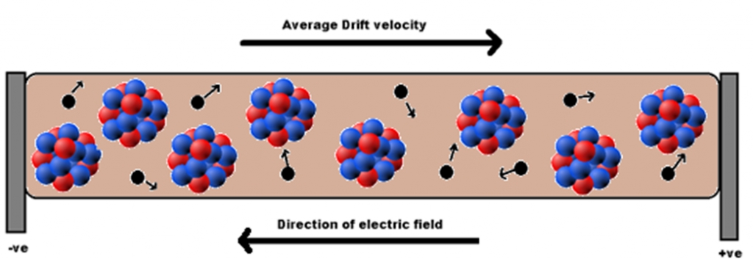
Semiconductors

Slide 46
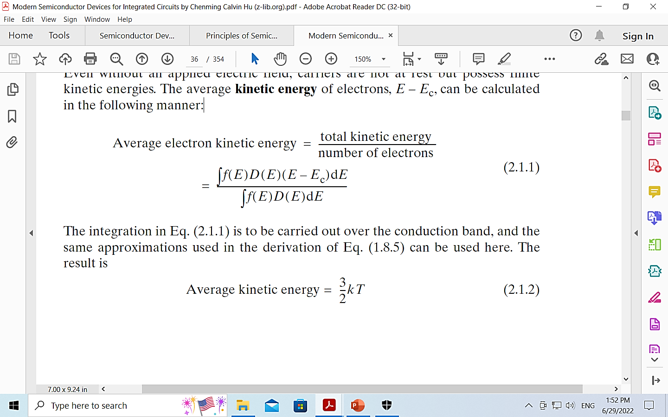
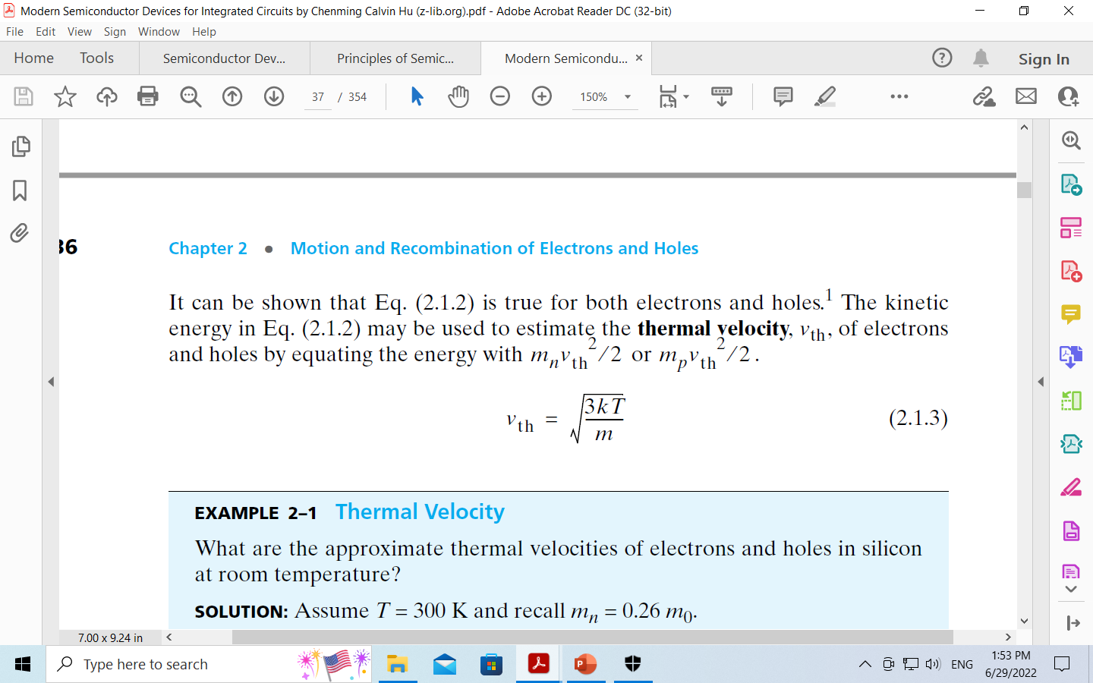
Semiconductors
Even without an applied electric field, carriers are not at rest but possess finite kinetic energies.
The average kinetic energy of electrons, E – Ec, can be calculated
in the following manner:

Slide 47
Semiconductors
Mechanisms of Carrier Scattering
There are two main causes: phonon scattering and ionized impurity scattering.
Phonons are the particle representation of the vibration of the atoms in the crystal
The dopant ions are fixed charge in the semiconductor crystal.
They can make electrons and holes change the direction of motion through the coulombic force.
An electron can be scattered by either a donor (positive) ion or an acceptor (negative) ion

Slide 48
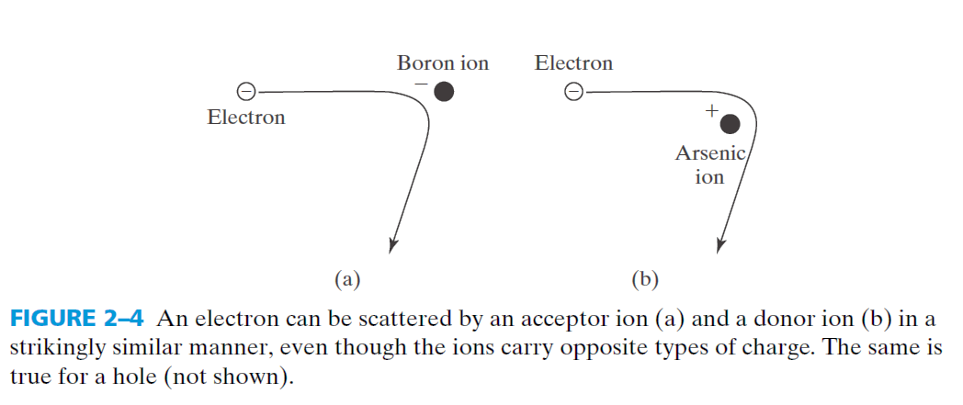
Semiconductors

Slide 49
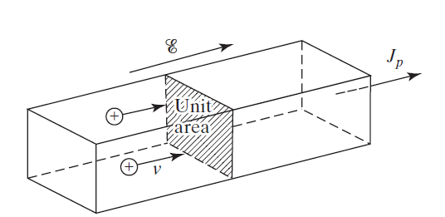
Semiconductors
Drift: is the motion of charge carriers caused by an electric field.
A P-type semiconductor bar of unit area is used to demonstrate the concept of current density.

Slide 50
Semiconductors
5. mobility, and conductivity
Energy bands with applied electric field
The bottom of the conduction band (EC) and the top of the valence band (EV ) correspond to the potential energies of electrons and holes, respectively.
the electric field in a semiconductor is expressed by the positive gradient of EC or EV :
The case of zero electric field can be visualized as flat bands (E_{C} and E_{V} do not change with x
The sign and the strength of the electric field can be visualized as the slope of E_{C} and E_{V}

Slide 51
Semiconductors
5. mobility, and conductivity
Both electrons and holes contribute to electric current.
Consider n type of semiconductor
When an electric field is exerted, electrons drift opposite to the field and carry a net electric current.
The electrons in a semiconductor have three degrees of freedom; the kinetic energy of the electrons is given by
Mh is the effective mass of the electron
Vth-thermal velocity of the electron
At room temperature (300 K), the thermal velocity of electrons 10⁷ cm/s for silicon and gallium arsenide
Calculate the velocity, taking the effective mass for conductivity and see weather it is correct or not

Slide 52
Semiconductors
5. Mobility and Conductivity
The random motion of electrons leads to zero net displacement of an electron over a sufficiently long period of time
The average distance between collisions is called the mean free path,
the average time between collisions is called the mean free time τc .
Schematic path of an electron in a semiconductor. (a) Random thermal motion. (b) Combined motion due to random thermal motion and an applied electric field.

Slide 53
Semiconductors
5. mobility, and conductivity
The momentum applied to an electron is given by –qEτc
the momentum gained is m_{n}υ_{n}
solve for velocity
The electrical conductivity, electron drift velocity and the electron mobility,
=
=
=
=

Slide 54
Semiconductors
5. mobility, and conductivity
=
=
Impurity scattering
Total ionization iimpurity
lattice scattering

Slide 55
Semiconductors
5. mobility, and conductivity
Mobilities and diffusivities in Si and GaAs at 300 K as a function of impurity concentration

Slide 56
Semiconductors
5. mobility, and conductivity
An applied electric field produces a drift current
the drift current is the sum of the individual electron and hole drift current densities,
The conductivity is given in units of ( Ω-cm⁾⁻¹

Slide 57
Semiconductors
5. mobility, and conductivity
Resistivity versus impurity concentration at T 300 K for silicon
As impurity increase resistivity decrease-why

Slide 58
Semiconductors
5. mobility, and conductivity
Resistivity versus impurity concentration at T 300 K for germanium, gallium arsenide, and gallium phosphide

Slide 59
Semiconductors
5. mobility, and conductivity
Carrier drift velocity versus electric field for high-purity silicon, germanium, and gallium arsenide.
Electron drift velocity
Hole drift velocity

Slide 60
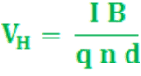
Semiconductors
Basic setup to measure carrier concentration using the Hall effect
Hall Effect is used to find
n-type or p-type.
carrier concentration.
mobility and conductivity.

Slide 61
Semiconductors
4. Generation (G) and Recombination ( R)
G=break-up of covalent bond to form electron and hole pairs
Requires energy from thermal or optical sources (or external sources).
Generation rate = G (th) + G(opt) + ….. [cm⁻³. s⁻¹]
R=formation of covalent bond by bringing together electron and hole
Releases energy in thermal or optical form
1 recombination event requires 1 electron + 1 hole
→ R ∝ n • p
E_{C}
R
G
E_{g}
E_{V}

Slide 62
Semiconductors
4. Generation (G) and Recombination ( R)
Generation

Slide 63
Semiconductors
4. Generation (G) and Recombination ( R)
Generation
All the electrons are bound through covalent bonds only at 0 K.
Certain number of covalent bonds can be broken at temperatures higher than 0 K- creating free electron–hole pairs
The energy needed to break a covalent bond in silicon crystal is about 1.1 eV at roomT

Slide 64
Semiconductors
4. Generation (G) and Recombination ( R)
In thermal equilibrium, these concentrations are independent of time–pn= ni² is valid.
In reality, electrons are continually being thermally excited from the valence band into the conduction band by the random nature of the thermal process- pn >ni²,

Slide 65
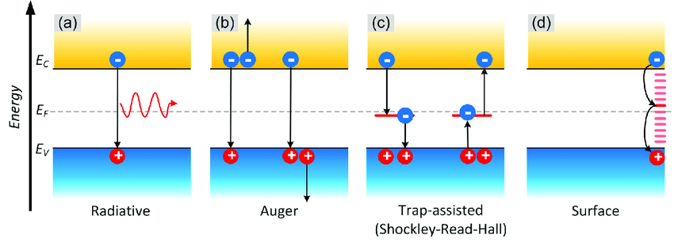
Semiconductors
4. Generation (G) and Recombination ( R)
Recombination- is the inverse process to generation
Four types of recombination –radiative, Auger, SRH, surface

Slide 66
Semiconductors
4. Generation (G) and Recombination ( R)
Intrinsic--Band to band, radiative band-to-band recombination and Auger band-to-band recombination
Auger recombination-- three charge processes
R_{A} = B_{A} · n³
Band to band recombination R_{b-b} = B_{b-b} · n²
Carrier concentration
recombination coefficient
recombination rate
Extrinsic (band-to-bound, trap-assisted, surface) recombination occurs via defects within energy bandgap.
Defect level recombination rate R_{defect}= B_{dl} · n_{dl} · n
Semiconductor surfaces represent defects in the crystal structure, and it is a space for many defect states within the forbidden gap

Slide 67
Semiconductors
Auger recombination -energy of transition is given to another carrier (the conduction band or the valence band),
This electron (or hole) then relaxes thermally (releasing its excess energy and momentum to phonons).

Slide 68
Semiconductors
Surface Recombination
abrupt discontinuity of the lattice structure at the surface,--localized energy states or generation-recombination centers
These surface states enhance the recombination rate at the surface region.
The total number of carriers recombining at the surface per unit area in unit time
the total number of carriers recombining at the surface per unit area and unit time can be simplified to
p_{s} denotes the hole concentrations at the surface, and N_{st} is the recombination center density per unit area

Slide 69
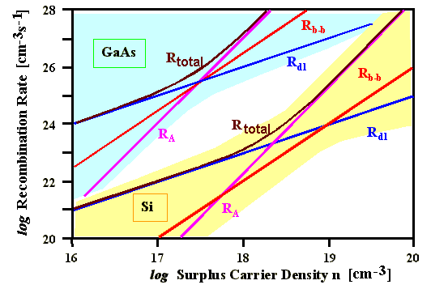
Semiconductors
4. Generation (G) and Recombination ( R)
If we plot the total recombination rate as a function of carrier density with the proper proportionality constants and some assumption for defect densities for GaAs and Si, we obtain the following highly informative picture.

Slide 70
Semiconductors
5. The p-n junction
A single-crystal material -one region is doped with acceptor impurity atoms to form the p region and the adjacent region is doped with donor atoms to form the n region.
Phosphorous doped
Boron doped
The space charge region, the electric field, and the forces acting on the charged carriers

Slide 71
Semiconductors
5. The p-n junction
A very large density gradient exists between both sides of the PN junction
free electrons migrate to the P-type material
they leave behind positively charged ions
the holes migrate to the n –type material
They leave behind negatively charged ions
Along the junction- P-type negative acceptor ions ( N_{a} ), and N-type positive N_{d} ions.
transfer of electrons and holes across the
PN junction is known as diffusion

Slide 72
Semiconductors
As these impurity charges are uncovered, an electric field (or electrostatic potential difference) is produced, which limits the diffusion of the holes and electrons.
The transition region between the n-type and the p-type semiconductors is called the space-charge region
The electrostatic potential difference resulting from the junction formation is called the built-in voltage, Vbi.
The electrostatics of this situation (assuming a single acceptor and a single donor level) are governed by Poisson’s equation

Slide 73
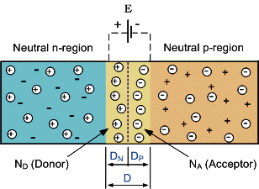
Semiconductors
5. The p-n junction
The electrostatics of this situation is governed by Poisson’s equation
In equilibrium Vbi occurs “potential barrier” zone around the area of the junction as the donor atoms repel the holes and the acceptor atoms repel the electrons.
the regions on either sides of the junction become completely depleted (Depletion Layer)of any more free carriers in comparison to the N and P type materials further away from the junction.

Slide 74
Semiconductors
Drift and diffusion
Majority diffuse across the junction—holes in the p side and electrons in the n side
Minority drift across junction ---electrons in the P side and holes in the n side
The ratio of μp and Dp is given by the Einstein relation

Slide 75
Semiconductors
5. The p-n junction
the built-in potential barrier can be determined as the difference between the intrinsic Fermi levels in the p and n regions.
The potential in the n region
Depends on thermal energy KT
impurity concentrations
Inversely with intrinsic concentration
The potential in the p region
built-in potential barrier for the step junction

Slide 76
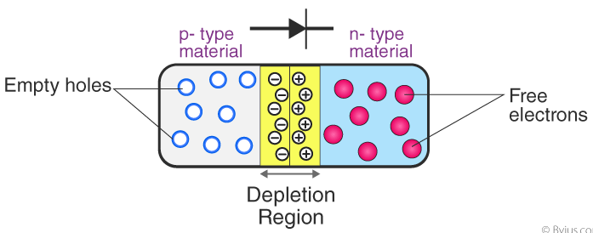
Semiconductors
5. The p-n junction
The Space Charge Width
the distance that the space charge region extends into the p and n regions from the metallurgical junction.
The total space charge width W is the sum of the two components
In the application of potential V to the junction

Slide 77


Semiconductors
5. The p-n junction
Energy-band diagram of a pn junction in thermal equilibrium.

Slide 78
Semiconductors
Built in potential
The change in fermi level in the n side --increases
The change in fermi level in the n side --decreases

Slide 79

Semiconductors
Zero bias
The potential barrier discourages the diffusion of any more majority carriers across the junction.
However, the potential barrier helps minority carriers (few free electrons in the P-region and few holes in the N-region) to drift across the junction.
Dynamic Equilibrium establishes

Slide 80

Semiconductors
Electric field and electric potential in junction
$\int_{x_{n}}^{x_{p}}{E}$dx

Slide 81

Semiconductors
A Reverse Bias -a positive voltage is
applied to the N-type material and a negative voltage is applied to the P-type material.
electrons are attracted towards the positive electrode and away from the junction
while the holes in the P-type end are also attracted away from the junction towards the negative electrode
Increase in the Depletion Layer due to Reverse Bias

Slide 82
Semiconductors
the Fermi energy level will no longer be constant through the system
the Fermi level on the n side is below the Fermi level on the p side. The difference between the two is equal to the applied voltage in units of energy.
Energy-band diagram of a pn junction under reverse bias.

Slide 83
Semiconductors
The total space charge width and the magnitude of the electric field in the depletion region increases with an applied reverse-biased voltage
The maximum electric fi eld still occurs at the metallurgical junction
The maximum electric fi eld at the metallurgical junction,
The junction capacitance can be written as

Slide 84

Semiconductors
zero current flows through the junction diode except a very small reverse leakage current
if voltage Vr is increased high enough value, it will cause the diode’s PN junction to overheat and fail due to the avalanche effect around the junction.
the diode become shorted and will result in the flow of maximum circuit current,

Slide 85

Semiconductors
a Forward Bias -negative voltage is applied to the N-type material and a positive voltage is applied to the P-type material.
external voltage greater than the potential barriers - current will start to flow.
the potential barrier, approx. 0.7 volts for silicon and 0.3 volts for germanium,
Reduction in the Depletion Layer due to Forward Bias

Slide 86

Semiconductors
the negative voltage pushes or repels electrons towards the junction -giving them the energy to cross over and combine with the holes ----being pushed in the opposite direction towards the junction by the positive voltage.
zero current flowing up to this voltage point, called the “knee” on the static curves and then a high current flow through the diode with little increase in the external voltage as shown below.

Slide 87

Semiconductors
Depletion width versus bias voltage

Slide 88
Semiconductors
5. The p-n junction—biasing
There are three biasing conditions for p-n junction diode and this is based on the voltage applied:
Zero bias: There is no external voltage applied to the p-n junction diode.
Forward bias: The positive terminal of the voltage potential is connected to the p-type while the negative terminal is connected to the n-type.
Reverse bias: The negative terminal of the voltage potential is connected to the p-type and the positive is connected to the n-type

Slide 89
Semiconductors
Some concepts
The work function represents the energy required to remove an electron from the semiconductor to the “free” vacuum level and is the difference between the vacuum level and the Fermi level.
Ionization energy is the amount of energy required to remove an electron from an isolated atom or molecule.
Activation energy is the minimum amount of energy that is required to activate atoms or molecules to a condition in which they can undergo chemical transformation or physical transport.

Slide 91
Semiconductors
The pn junction current
No bias
reverse bias
forward bias

Slide 92
Semiconductors
The pn junction current
An applied forward-bias voltage reduces the electric field force that prevented majority carriers from crossing the space charge region ;
Barrier reduced, Vbi ------→ Vbi-Va

Slide 93
Semiconductors
The pn junction current
Majority carrier electrons from the n side are now injected across the depletion region into the p material
majority carrier holes from the p side are injected across the depletion region into the n material.
As long as the bias Va is applied, the injection of carriers across the space charge region continues and a current is created in the pn junction.
the minority carrier concentration, n_{p} in the p region is given by

Slide 94

Semiconductors
The pn junction current
If we assume low injection, the majority carrier electron concentration n_{n0}, for example, does not change significantly.
the minority carrier concentration, n_{p}, can deviate from its thermal-equilibrium value n_{p0} by orders of magnitude
the total minority carrier electron concentration in the p region is
The injection is an exponential function of forward bias voltage
Decays exponentially with temperature, why?

Slide 95

Semiconductors
The pn junction current
the majority carrier holes in the p region are injected across the space charge region into the n region under a forward-bias voltage.
The concentration of holes in n region is

Slide 96
Semiconductors
The pn junction current
Steady-state minority carrier concentrations in a pn junction under forward bias.
The concentration decays when we go a way from the depletion layer edge because as minority carriers diffuse from the space charge edge into the neutral semiconductor regions, they recombine with majority carriers

Slide 97
Semiconductors
The pn junction current
Minority carrier concentration changes with changing forward-bias voltage

Slide 98
Semiconductors
Quasi-Fermi levels through a forward-biased pn junction

Slide 99
Semiconductors
Ideal pn Junction Current
The total current in the junction is the sum of the individual electron and hole currents that are constant through the depletion region.
Since the electron and hole currents are continuous functions through the pn junction, the total pn junction current will be the minority carrier hole diffusion current at x = xn plus the minority carrier electron diffusion current at x = xp.
The gradients in the minority carrier concentrations produce diffusion currents
we are assuming the electric field to be zero at the space charge edges, we can neglect any minority carrier drift current component.

Slide 100
Semiconductors
Ideal pn junction current

Slide 101
Semiconductors
Ideal pn junction current
The ideal-diode equation, gives a good description of the current–voltage characteristics of the pn junction over a wide range of currents and voltages.
Although it was derived assuming a forward-bias voltage (Va 0), there is nothing to prevent Va from being negative (reverse bias).
the reverse-biased current density becomes independent of the reverse-biased voltage
The parameter Js is referred to as the reverse-saturation current density
the forward-bias current–voltage characteristic when plotted on a log scale plot yields a straight line when Va is greater than a few kT/eV

Slide 102
Semiconductors
The drift of majority carrier holes in the p region far from the junction is to supply holes that are being injected across the space charge region into the n region and also to supply holes that are lost by recombination with excess minority carrier electrons.
Ideal electron and hole current components through a pn junction under forward bias.

Slide 103
Semiconductors
Ideal pn junction current
Forward-bias current versus voltage from low forward bias to high forward bias.
The plot shows the effect of recombination at low-bias voltages and high-level injection at high-bias voltages.

Slide 104

Semiconductors
Temperature Effects
For a silicon pn junction, the ideal reverse-saturation current density will increase by approximately a factor of 4 for every 10C increase in temperature
The forward-bias current can be written as follows

Slide 105
Semiconductors
Generation–Recombination Currents
High-level injection and other current components generated within the space charge region the I–V relationship to deviate from the ideal expression
The recombination rate of excess electrons and holes, given by the Shockley– Read– Hall recombination theory, was written as

Slide 106

Semiconductors
Metal–Semiconductor junctions
Rectifying and ohmic
The metal–semiconductor diode
The work function,

Slide 107
Semiconductors
There are two kinds of metal–semiconductor junction.
The junctions between metal and lightly doped semiconductors exhibit rectifying IV characteristics similar to those of PN junctions.
They are called Schottky diodes and have some interesting applications.
The junction between metal and heavily doped semiconductors behaves as low-resistance ohmic contacts (basically electrical shorts).
Ohmic contacts are an important part of semiconductor devices and have a significant influence on the performance of high-speed transistors.

Slide 108

Semiconductors
Schottky diode is a metal-semiconductor junction diode that has less forward voltage drop than the P-N junction diode and can be used in high-speed switching applications.
In schottky diode, metals such as aluminum or platinum replace the P-type semiconductor.
Schottky diodes are widely used in radio frequency (RF) application

Slide 109


Semiconductors
Reverse bias schottky diode and Forward biased schottky diode
See the depletion region
The depletion region in the metal side is small in size because of charge screening
Electric field doesn’t penetrate a metal

Slide 110
Semiconductors
The parameter φ is the metal work function (measured in volts) and x is the electron affinity of the semiconductors

Slide 111
Semiconductors
Work function of metal is greater than that of the semiconductor
Energy-band diagram of a metal and semi conductor before contact;
ideal energy-band diagram of a metal–n-semiconductor junction for

Slide 112
Semiconductors
The parameter B0 is the ideal barrier height of the semiconductor contact, the potential barrier seen by electrons in the metal trying to move into the semiconductor.
This barrier is known as the Schottky barrier and is given, ideally, by
On the semiconductor side, Vbi is the built-in potential barrier. This barrier, similar to the case of the pn junction, is the barrier seen by electrons in the conduction band trying to move into the metal. The built-in potential barrier is given by

Slide 113
Semiconductors
Metal–Semiconductor junction
positive voltage to the semiconductor with respect to the metal, the semiconductor-to-metal barrier height increases, while φ_{B0} remains constant
forward bias
reverse-biased voltage
positive voltage is applied to the metal with respect to the semiconductor, the semiconductor-to-metal barrier Vbi is reduced while φ_{B0} again remains essentially constant.
reverse bias

Slide 114
Semiconductors
positive voltage applied to the metal with respect to the semiconductor, electrons can more easily flow from the semiconductor into the metal since the barrier has been reduced.
a linear function of distance, for the uniformly doped semiconductor, and reaches a peak value at the metal–semiconductor interface
The space charge region width, W, may be calculated as we do for the pn junction

Slide 115
Semiconductors
Interface states
In the energy-band diagram of a metal to n-type semiconductor contact in thermal equilibrium , we assume that a narrow interfacial layer of insulator exists between the metal and semiconductor.
The interfacial layer can support a potential difference, but will be transparent to the fl ow of electrons between the metal and semiconductor.
The semiconductor also shows a distribution of surface states at the metal–semiconductor interface. We assume that all states below

Slide 116
Semiconductors
Interface states
The diagram shows some acceptor states above φ0 and below EF.
These states tend to contain electrons and are negatively charged.
the surface state density is assumed constant and equal to D_{it} states/cm2 -eV.
The relation between the surface potential, surface state density, and other semiconductor parameters is

Slide 117
Semiconductors
Interface states
Current–Voltage Relationship
the current transport in a metal–semiconductor junction is due mainly to majority carriers as opposed to minority carriers in a pn junction.
The basic process in the rectifying contact with an n-type semiconductor is by transport of electrons over the potential barrier, which can be described by the thermionic emission theory
The thermionic emission characteristics are derived by assuming that the barrier height is much larger than kT, so that th

Slide 118
Semiconductors
Interface states
The thermionic emission characteristics are derived by assuming that the barrier height is much larger than kT,
The current J _{s → m} is the electron current density due to the flow of electrons from the semiconductor into the metal
The current J _{m→s} is the electron current density due to the flow of electrons from the metal into the semiconductor.
Energy-band diagram of a forward-biased metal– semiconductor junction including the image lowering effect.

Slide 119
Semiconductors
Interface states
The parameter A* is called the effective Richardson constant for thermionic emission.
Experimental and theoretical reverse-biased currents in a PtSi–Si diode.

Slide 120
Semiconductors
Why the deplation layer is in the semiconductor I the case of semiconductor metal junction
When the two materials are brought into contact, the matching of the Fermi levels invariably causes charge to flow from one side to the other, and a dipole layer is built up at the interface.
In the metal, the participating charge is screened within a few Ångstroms,
In a semiconductor, the free carrier concentration is orders of magnitude lower than in a metal and thus shielding is much less effective.
In the semiconductor a normal space-charge layer, depletion or accumulation, is formed,

Slide 121
Semiconductors
The charge distribution (the total charge due to the junction)
Firstly, there is the charge Q_{d} in the depletion region which results from the movement of electrons out of the semiconductor into the metal (+ve).
Secondly, there is a charge Q_{m} on the metal surface which is caused by the electrons that have crossed from the semiconductor into the metal (-ve).
Finally, if the band bending is sufficiently large, there will occur a charge Q_{h} due to holes which exist in the semiconductor region just adjacent to the metal contact (+ve).
Electrical neutrality in the junction region requires that Q_{d} + Q_{m} + Q_{h} = 0,

Slide 122

Electric field and potential distributions in the depletion region of a Schottky barrier.
Energy band diagram;
electric field distribution;
potential distribution. The solid lines correspond to a reverse bias VR and the dashed lines to VR + small change
Qd
Qm
Qh

Slide 123
Semiconductors
1. High-work-function metal and n-type semiconductor
Note Efs > Efm-rectify
electrons flow from the semiconductor to the metal after contact to lower their energy
As the electrons leave the semiconductor, a positive charge, due to the ionized donor atoms, stays behind.
This charge creates a negative field and lowers the band edges of the semiconductor
The positive space charge is balanced on the metal side by a corresponding excess electronic charge extending only over an atomic distance

Slide 124
Semiconductors
2. low-work-function metal and n-type semiconductor
EfS <Efm--ohmic
Energy level diagrams of metal contacts to η-type semiconductors for work function of metal less than work function of semiconductor.
It dosnt act as rectifier since no barrier
It is ohmic since virtually no barrier exists in the conduction band

Slide 125
Semiconductors
3. low work function metal and p type semiconductor
Efm>Efs--rectify
the band alignment gives rise to a built-in potential barrier
the potential barrier arises because of a charge transfer from the semiconductor (higher Fermi level) to the metal.
The charges transferred (holes) leave behind uncompensated acceptor atoms
a positive charges accumulation on the surface of the metal (extra conduction carrier contained within a Thomas Fermi screening distance ~0.1 Å

Slide 126
Semiconductors
4. high-work-function metal and p-type semiconductor,
Efm <Efs ---ohmic
the band alignment at thermal equilibrium leads to an upward semiconductor band bending at the interface related to a hole accumulation
If such junction is biased (V) so that holes flow from the semiconductor to the metal, they encounter no barrier
The junction is ohmic

Slide 127
Semiconductors
Junction Barrier –metal – n type
In the ideal Schottky barrier the height of the barrier at the semiconductor-metal junction, is defined as the difference between the semiconductor conduction band at the junction and the metal Fermi level
The potential eV_{bi} is called the built-in potential of the junction and is given by

Slide 128
Semiconductors
Junction Barrier –metal – p type
In the case of a metal-p-type semiconductor junction where φm < φs.
at equilibrium the electrons are injected from the metal to the semiconductor, causing a negative charge on the semiconductor side.
The bands are bent a barrier is created for hole transport.
The height of the barrier seen by the holes in the semiconductor is

Slide 129
Semiconductors
Measurement of barrier height
1. Capacitance-Voltage Measurement
In this method the diode capacitance is measured as a function of applied reverse bias.
When a small ac voltage of a few millivolts is applied to a reverse biased diode the depletion region capacitance C is given by the relation
where S is the diode cross-sectional area, Es is the permittivity of the semiconductor, VR is the applied reverse voltage,
a plot of I/C² versus V_{R} gives a straight line with slope 2/S²EsqNd and an intercept on the voltage axis Vo = (Vi - kT/q).
The slope of the straight line can be used to determine the dopant concentration Nd

Slide 130
Semiconductors
2. Current-Voltage Measurement
the current is due to thermionic emission of electrons over the barrier and the current as a function of applied bias V is given by the relation
The diode forward I -V characteristics are obtained at a number of temperatures and 1₀ determined at each temperature.
A plot of ln(I₀/T²) against 1/T then gives a straight line whose slope gives the barrier height φB

Slide 131
Semiconductors
3. Photoelectric Measurement
The photoelectric method is the most accurate and direct method of determining φB’
When a monochromatic light is incident on a metal in contact with the semiconductor and the photon energy hv is larger than the barrier height but smaller than the band gap of the semiconductor, the incident photons will excite some electrons from the metal over the barrier.

Slide 132
Semiconductors

Slide 133
Barrier heights of Si-Schottky contacts versus metal work function. The data were obtained by different researchers from measurements on the metal-covered Si(11 J)-(2x
Lüth H. (1995) Metal-Semiconductor Junctions and Semiconductor Heterostructures. In: Surfaces and Interfaces of Solid Materials. Springer Study Edition. Springer, Berlin, Heidelberg

Slide 134
: Schottky barrier heights (in volts) for several metals on n- and p-type semiconductors.

Slide 135


Slide 137
Semiconductors
Heterojunction—different semiconductors

Slide 138
Semiconductors
Construction of a Heterojunction Energy Band Diagram
Consider the energy band diagram for GaAs on Ge. assuming that the bulk properties of the semiconductors are valid right up to the interface where there is an abrupt transition from one material to the other.

Slide 139
Semiconductors
Energy band of the individual GaAs and Ge

Slide 140
Semiconductors
No external applied voltage bias;.
the presence of the very large barrier in the valence band of the heterojunction prevents the injection of holes from p-Ge into n-GaAs.

Slide 141
Semiconductors
APPLICATION TO OPTOELECTRONIC DEVICES
Commonly made of silicon, solar cells, also known as photovoltaic cells, can covert sunlight to electricity with 15 to 30% energy efficiency.
A solar cell’s structure is identical to a PN junction diode with transparent electrodes so that light can strike the semiconductor.
a voltage, without light, can produce a diode current
Light is also a driving force that can produce a diode current without voltage, i.e., with the two diode terminals short-circuited so that V = 0.
The total diode (solar cell) current is the sum of the current generated by the voltage and that generated by light.

Slide 142
Semiconductors
When light shines on the PN junction, the minority carriers that are generated by light within a diffusion length from the junction can diffuse to the junction
swept across the junction by the built-in field, and cause a current to flow out of the P terminal through the external short circuit and back into the N-terminal.
This current is called the short-circuit current, Isc.
Isc is proportional to the light intensity and to the cell area,

Slide 143
Semiconductors
Light Penetration Depth—Direct-Gap and Indirect-Gap Semiconductors
The photon energy and the wavelength, are related by
Photons with energy larger than Eg are absorbed
some photons may travel a distance x in the semiconductor before being absorbed.
The light intensity decreases exponentially with the distance of travel x
α is called the absorption coefficient and 1/α may be called the light penetration depth
A solar cell must have a thickness significantly larger than the light penetration depth in order to capture nearly all the photons.

Slide 144
Semiconductors
a Si solar cell should be no thinner than 50 μm in order to absorb most of the photons with energy above Eg.
On the other hand, a GaAs solar cell needs to be only 1 µm thick because its absorption coefficient rises steeply when the photon energy exceeds Eg.
Light absorption coefficient as a function of photon energy. Si and Ge are indirect-gap semiconductors.
InAs, GaAs, and GaN are direct-gap semiconductors, which exhibit steeply rising absorption coefficients

Slide 145
Semiconductors
a schematic E–k plot of Si and Ge.
They are called indirect-gap semiconductors.
Light absorption is inefficient because assistance by phonons is required to satisfy k conservation
the bottom of the conduction band and the top of the valence band occur at the same k,
InP and GaN, are directgap semiconductors.
A photon can move an electron from the valence band to the conduction band efficiently because k conservation (the equivalent of momentum conservation) is satisfied.

Slide 146
Semiconductors
Output Power
There is a particular operating point on the solar cell IV curve that maximizes the output power,
A load-matching circuit is usually employed to ensure that the cell operates at that point.
where FF (called the fill factor)

Slide 147
Semiconductors
Light-emitting diodes and solid-state lighting
Photons are generated when the electrons and holes injected by the PN junction recombine.
The electrons and holes in direct-gap materials have matching wave vectors and can recombine easily.
Direct-gap such as GaN are much better for LED applications- high quantum efficiency
than indirect-gap semiconductors such as Si-low quantum efficiency

Slide 148
Semiconductors
a red LED with its substrate shaped into a truncated pyramid to collected light with reflector on the back and total internal reflection from the sides.
The GaP substrate is transparent to red light.
A red LED with sloped sides for better light extractio

Slide 149
Semiconductors

Slide 150
Semiconductors

Slide 151


Semiconductors
DIODE LASERS
Diode lasers-- Their basic structure has a PN junction under forward bias.
Diode lasers, as LEDs, employ direct-gap semiconductors for efficient light emission.
highly reflective at one end and a partially reflective at the other end, - a resonant cavity

Slide 152
Semiconductors
(a–c) Three types of light–electron interactions; (d) light is absorbed in the semiconductor; and (e) under population inversion, light (wave amplitude) is amplified in the semiconductor

Slide 153

Semiconductors
Photodiodes
It is PN junction which converts light energy into electrical energy
Between the p (positive) and n (negative) layers, an intrinsic layer is present.
Photodiode operates in reverse bias condition -- p – side -v and n – side to +ve
Internally, a photodiode has optical filters, built in lens and a surface area
A thin top P-type layer allows most photons to pass into the depletion region where electron-hole pairs are formed
https://instrumentationtools.com/topic/special-purpose-diodes/

Slide 154
Semiconductors
Simple circuit diagram (left) and current-voltage (I − V ) plot showing regimes of operation for a p − n diode under illumination.
When operated in quadrant III, the device acts as a photodetector, whereas in quadrant IV it behaves as a solar cell

Slide 155
Semiconductors
Transistor
Transistor inventors John Bardeen, William Shockley, and Walter Brattain (left to right) at Bell Telephone Laboratories

Slide 156


Semiconductors
Transistor basics

Slide 157

Semiconductors
Transistor basics ---bipolar junction transistor—current controlled
A bipolar transistor consists of a three-layer “sandwich” of doped (extrinsic) semiconductor materials, either P-N-P or N-P-N
Each layer forming the transistor has a specific name, and each layer is provided with a wire contact for connection to a circuit

Slide 158

Semiconductors
Working Principle
Bipolar transistors work as current-controlled current regulators.
In other words, transistors restrict the amount of current passed according to a smaller, controlling current.
The main current that is controlled goes from collector to emitter, or from emitter to collector, (PNP or NPN)
The small current that controls the main current goes from base to emitter, or from emitter to base, (PNP or NPN).
No current through the base shuts it off
A base current, turns it on

Slide 159

Semiconductors
Filed effect transistors- voltage-controlled
All field-effect transistors are unipolar rather than bipolar devices.
the main current through them is comprised either of electrons through an N-type semiconductor or holes through a P-type semiconductor.
In JFET, the controlled current passes from source to drain, or from drain to source.
The controlling voltage is applied between the gate and source
the current does not have to cross through a PN junction on its way between source and drain:
the path (called a channel) is an uninterrupted block of semiconductor material.

Slide 160
Semiconductors
Transistor basics
(a) Polysilicon-gate/oxide/semiconductor capacitor and (b) its energy band diagram with no applied voltage.

Slide 161
Semiconductors
Transistor basics
SURFACE ACCUMULATION
if a more negative Vg than Vfb is applied, the band diagram on the gate side would be pushed upward
This MOS capacitor is biased (a) Types of charge present. ⊕ represents holes and – represents negative charge.
(b) Energy band diagram.

Slide 162
Semiconductors
Transistor basics
The voltage relation ship
V_{fb}, the flat-band voltage
ψ_{g} and ψ_{s} are the gate work function and the semiconductor work function,
where C_{ox} is the oxide capacitance per unit area Qacc is the accumulation charge

Slide 163
Semiconductors
Transistor basics
SURFACE DEPLETION
If a more positive V_{g} than V_{fb} is applied, the band diagram on the gate side will be pulled downward
there is a depletion region at the surface because E_{F} is far from both E_{c} and E_{v}

Slide 164
Semiconductors
Transistor basics

Slide 165
Semiconductors
Transistor basics
STRONG INVERSION BEYOND THRESHOLD
shows the energy diagram at strong inversion, Vg > Vt. As shown in Fig. 5–9a, there is now an inversion layer, which is filled with inversion electrons. The inversion charge density is represented with Qinv (C/cm2). φs does not increase much further beyond 2φB since even a 0.1 V further increase in φs would induce a much larger surface electron density and therefore a larger Vox that would soak up the Vg in Eq. (5.2.2). If φs does not increase, neither will the depletion region width. Approximately speaking, Wdep has reached its maximum value

Slide 166
Semiconductors
Field Effect Transistor
A field-effect transistor shortly termed as FET is a device, unlike BJT which is a current controlled device.
The FET is a unipolar device, which means that it is made using either p-type or n-type material as the main substrate.
One of the many of its advantages is that it has a very high input impedance, which is in the order of Mega Ohms.
It has many other advantages such as low heat dissipation and low power consumption

